Slide 1



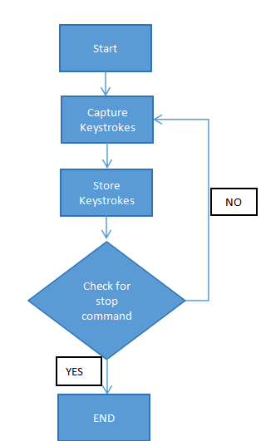
Keylogger Software for Monitoring and Surveillance
Hemanshu Moundekar, Durgesh Borse, Sourabh Karmakar
Faculty Guide:
Prof. Uday Mande
Proposed Method
Results and Output Screen
Abstract/ Project Insights: The need for keyloggers arises primarily in security-related scenarios such as monitoring employee activity, parental control, or investigating unauthorized access. However, keyloggers also pose significant ethical and privacy concerns when used without consent, leading to potential misuse, data breaches, and legal implications. Ideation on keyloggers involves considering their ethical and practical implications. Keyloggers, software or hardware tools that record keystrokes on a computer, can serve legitimate purposes like parental control or employee monitoring. However, they are frequently associated with malicious intent, such as stealing sensitive information like passwords or financial data. Ethical considerations include ensuring user consent and lawful use. From a practical standpoint, keyloggers require robust security measures to prevent misuse and protect user privacy.
Future Scope: Developing a software to monitoring employee activity for security purposes, parental control to ensure child safety online, and forensic investigations into unauthorized access. In these contexts, keyloggers can provide valuable insights into user behavior and help prevent security breaches or identify wrongdoing.
IPR and Awards : (Link of research paper / copyrights / Patents / Etc
Add QR code of your project document folder link from dashboard

